Slide 1


INVENTRA'25 - PROJECT EXPO
FAKE SOCIAL MEDIA PROFILE DETECTION AND REPORTING SYSTEM
PRESENTED BY: TEAM CCS-23
GUIDED BY: Assistant Prof. Sterlin Minish TN

Slide 2
The Growing Crisis in Digital Spaces
Fake social media profiles pose a significant threat to individuals and digital ecosystems alike. The scale of this problem is rapidly escalating, making robust detection solutions critical.
300+ million
65%
Fake profiles created annually
Of internet users have encountered fake profiles
$6+ billion
40% Increase
Lost to social media scams yearly
In identity theft through fake accounts
"Traditional methods can't keep up with the scale and sophistication of modern fake profiles."

Slide 3



Our Multi-Layered Detection Engine
Our system employs a sophisticated, multi-faceted approach to identify and classify fake social media profiles with high accuracy.
REAL-TIME API INTEGRATION
Live data extraction from diverse social platforms including Instagram, Facebook, Twitter, and TikTok, powered by ScrapingDog API for accuracy.
RULE-BASED ANALYSIS ENGINE
Seven critical factors analysed: profile completeness, follower ratio, username patterns, posting behaviour, content similarity, account age, and verification status.
INTELLIGENT RISK SCORING
A weighted algorithm provides a comprehensive assessment, classifying profiles as Genuine, Suspicious, or Fake with detailed factor breakdowns.

Slide 4

Technical Architecture Overview
Our system is built on a robust and scalable architecture designed for efficient data processing and seamless user interaction.
User Interface
Responsive web UI
Data Flow Architecture
Django Backend
Twitter API
Data & auth
API endpoints & logic
Instagram API
Database
Data & auth
Persistent storage
User Interface
Django Backend
Responsive web design, easy navigation, and real-time results display for optimal user experience.
Handles authentication, powers the detection engine, and manages reports and risk analytics.

Slide 5
Step-by-Step Implementation
Our user-friendly process allows for quick and accurate fake profile detection.
01
02
03
USER INPUT
DATA EXTRACTION
MULTI-FACTOR ANALYSIS
Simply paste the social media profile URL and select the platform (or allow auto-detection).
Real-time API calls gather comprehensive profile information and recent activity from the chosen social platform.
Our 7-point rule engine executes pattern recognition algorithms and behavioural analysis to identify anomalies.
04
05
RISK ASSESSMENT
ACTION & REPORTING
A comprehensive score (0-100%) is generated, providing a factor-by-factor breakdown and a clear classification output.
Users receive detailed results, with the option for one-click reporting and a history tracking feature.

Slide 6

Case Study: Suspicious Friend Request
Witness our system in action as it helps a user identify and avoid a potential scam.
Scenario:
Results:
A user receives a friend request from an unknown profile with minimal information and suspicious activity patterns.
⚠️ RISK SCORE: 78% (SUSPICIOUS)
Our Solution in Action:
Profile Completeness: 20% (High Risk)
Follower Ratio: 85% following / 15% followers
1. USER ACTION: User pastes the profile URL into our system.
Username Pattern: Random character generation detected
2. SYSTEM ANALYSIS: Extracts 150+ data points, analyses 7 risk factors simultaneously, and processes behavioural patterns.
Account Age: 3 days with 200+ posts
Verification: Not verified
Outcome:
The user successfully avoids a potential scam and is empowered to report the suspicious profile.

Slide 7



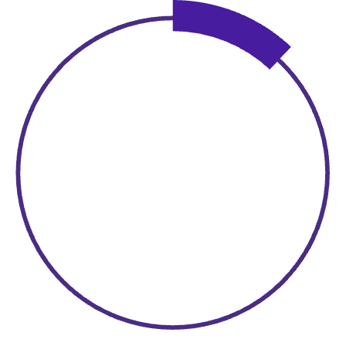
Tangible Benefits & Achievements
Our system delivers significant value, fostering a safer and more transparent digital environment.
FOR INDIVIDUAL USERS:
FOR THE COMMUNITY:
✅ Protection from financial scams and identity theft
✅ Reduces spread of misinformation
✅ Empowerment through data-driven decisions
✅ Creates digital accountability
✅ Safe online social interactions
✅ Contributes to safer online ecosystems
✅ Transparent risk assessment
✅ Educational value in digital literacy
Quantifiable Results:
85%
3-5
Accuracy
Seconds
In fake profile detection
Average processing time
100+
<12%
Scans
False Positive
Successful during testing
Rate

Slide 8






TEAM CCS-23: Diverse Skills, Unified Vision
Our collaborative effort brought together distinct expertise to deliver this innovative solution.
SYED SAIFULLA H
CHINNMAY
SIDDHARTH SHEKHAR
Team Lead
Algorithm Specialist
Frontend Lead
Backend Architecture & API Integration
Detection Engine Development
User Interface Design
Machine Learning Implementation
User Experience Optimization
Database Design & Optimization

Slide 9






What Sets Our Solution Apart
We've engineered a system that stands out through its comprehensive capabilities and user-centric approach.
Comprehensive Multi-Platform Support
Real-Time Analysis Engine
Transparent Risk Breakdown
Live data processing delivers instant results, eliminating delays associated with batch processing.
Detailed, factor-by-factor analysis offers educational value and evidence-based conclusions for users.
Unified detection across Instagram, Facebook, Twitter, and TikTok for broad coverage.
User-Centric Design
Scalable Architecture
Intuitive interface requiring no technical expertise, coupled with a mobile-responsive design.
Modular rule engine and easy integration of new platforms ensure an enterprise-ready infrastructure.

Slide 10
THANK
YOU

